Slide 1
COMPARISON OF DETROIT HOMICIDE AND CARJACKING LOCATIONS

Slide 2
Finding crime patterns is important to fight it
Governance has to tackle crime and the law enforcement needs all the tools to curb it
Violent crimes take the higher priority
Homicide and carjacking are two such categories
DPD as well as city council have interest in order to help society

Slide 3
Data acquisition and cleaning
City of Detroit Open Data Portal website provides data for all of its crime categories
https://data.detroitmi.gov/datasets/dpd-carjacking-offenses-victims-confirmed
https://data.detroitmi.gov/datasets/dpd-homicide-offenses-victims-confirmed
1271 and 594 rows respectively
Repetitive / duplicate data was dropped, formatting was standardized

Slide 4
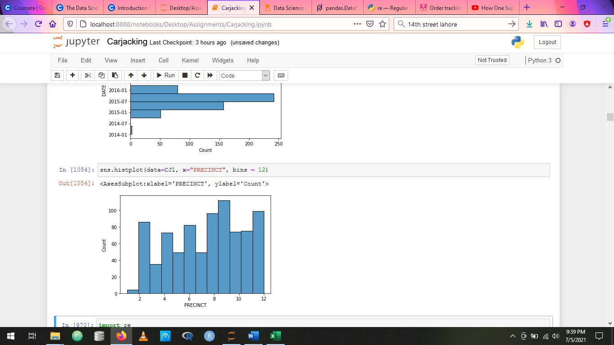
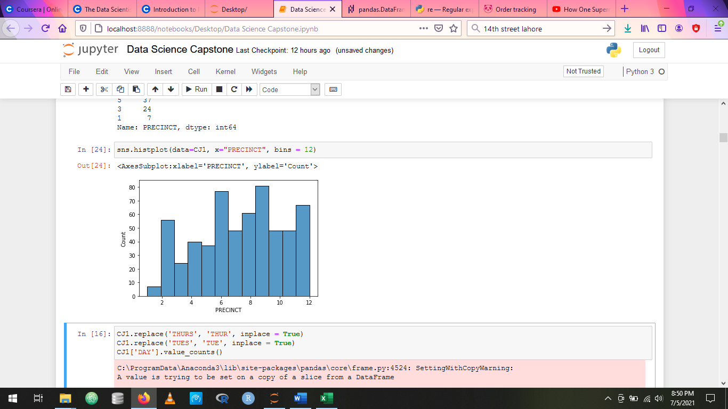
DPD precinct vise crime distribution
Carjacking
Homicide

Slide 5
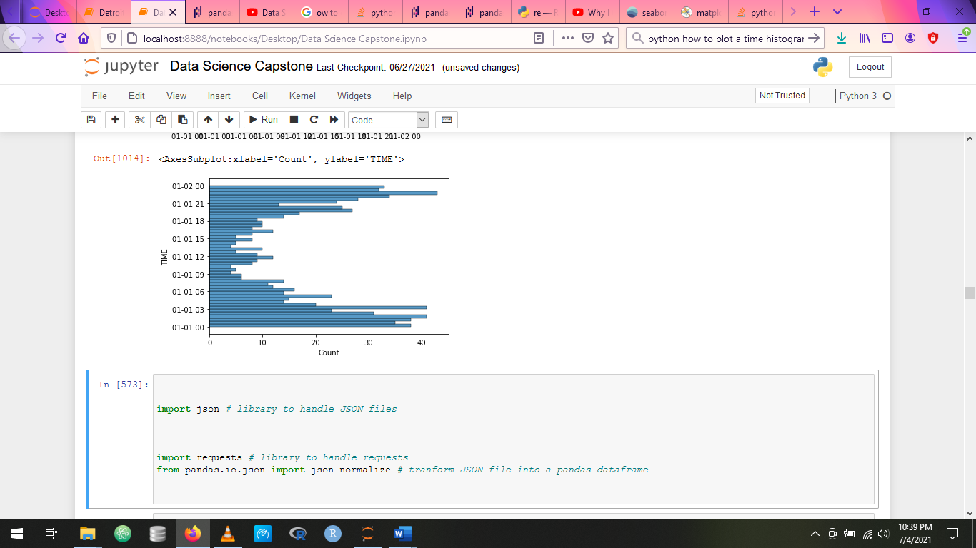
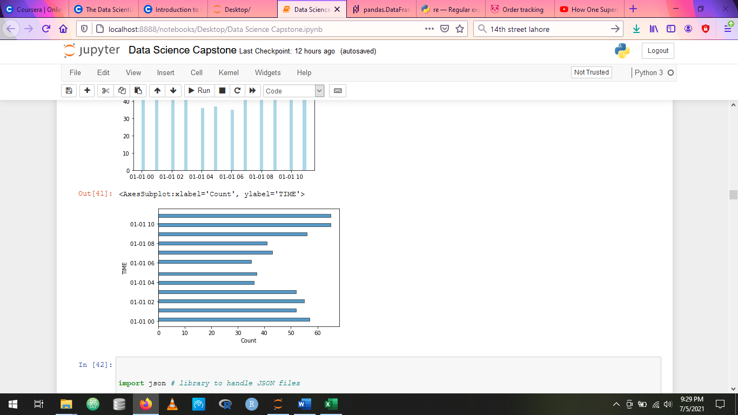
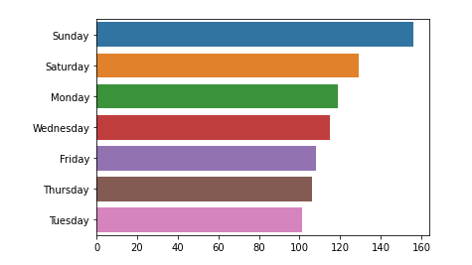
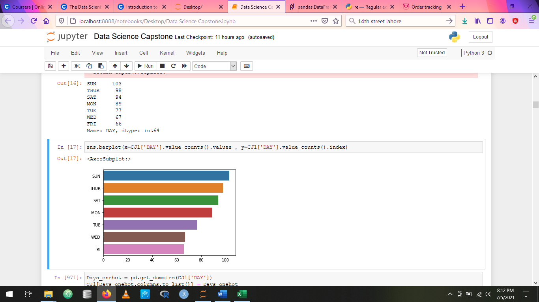
Time and day vise distributions
Carjacking Homicide

Slide 6
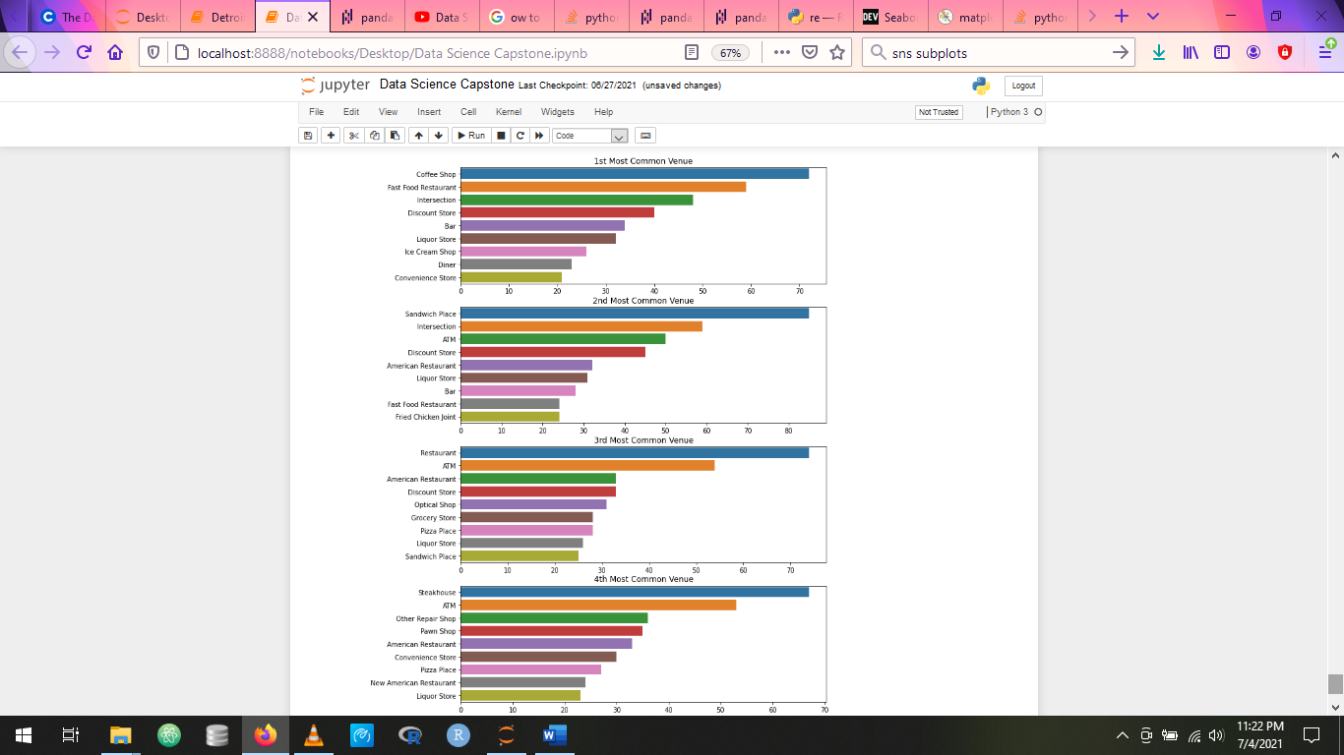
Carjacking most common venues

Slide 7
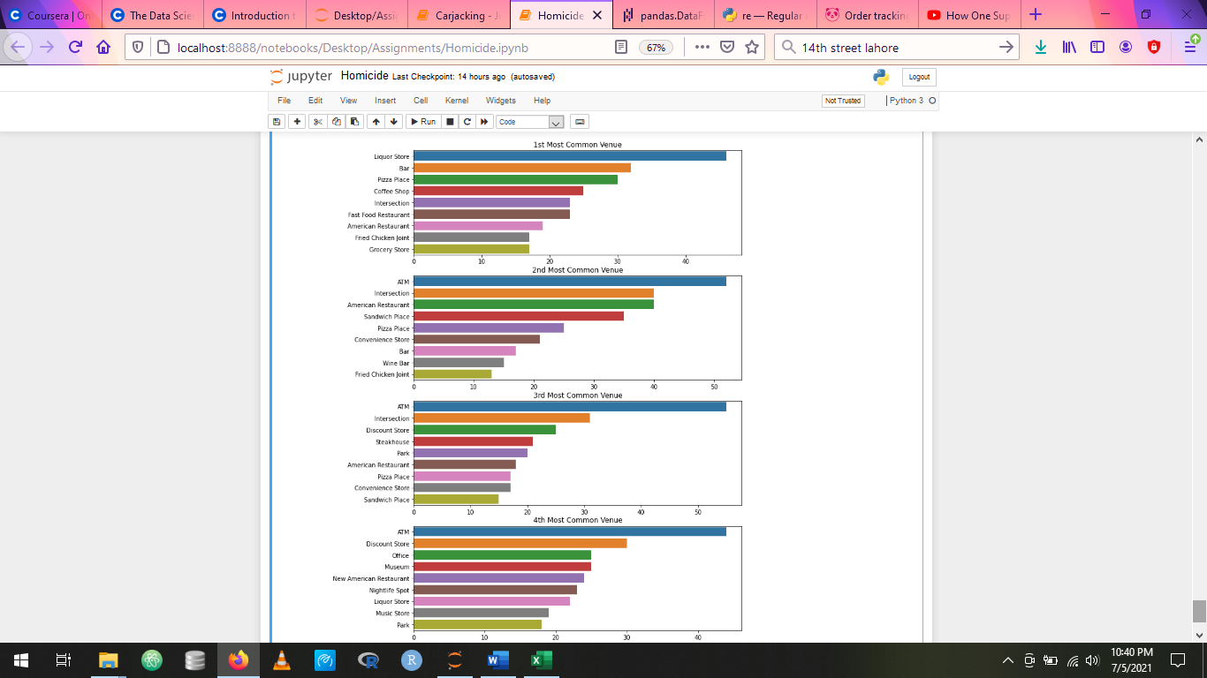
Homicide most common venues

Slide 8
Applying the model
K-Means Clustering
K = 16 for optimum clusters
Initially all features were used
Later on features causing unwanted bias were dropped to focus on venues themselves

Slide 9
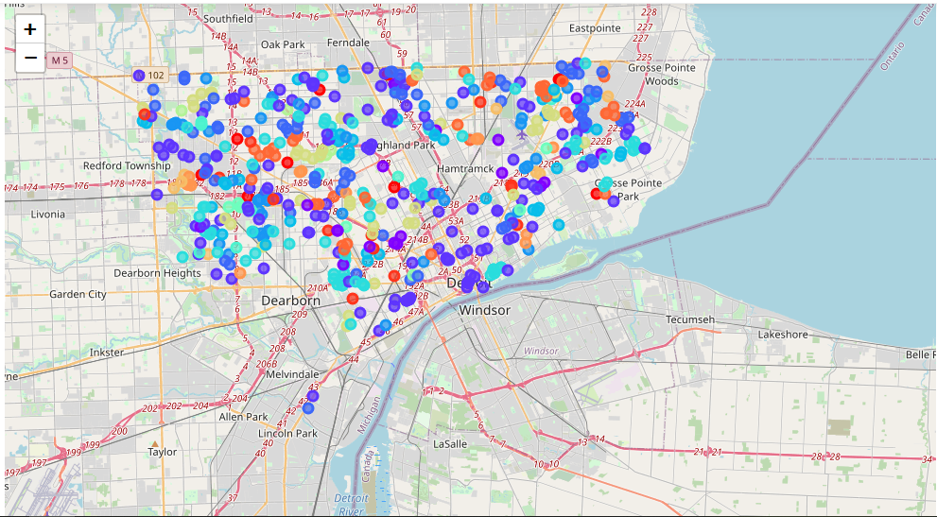
Detroit Homicide locations / Clusters

Slide 10
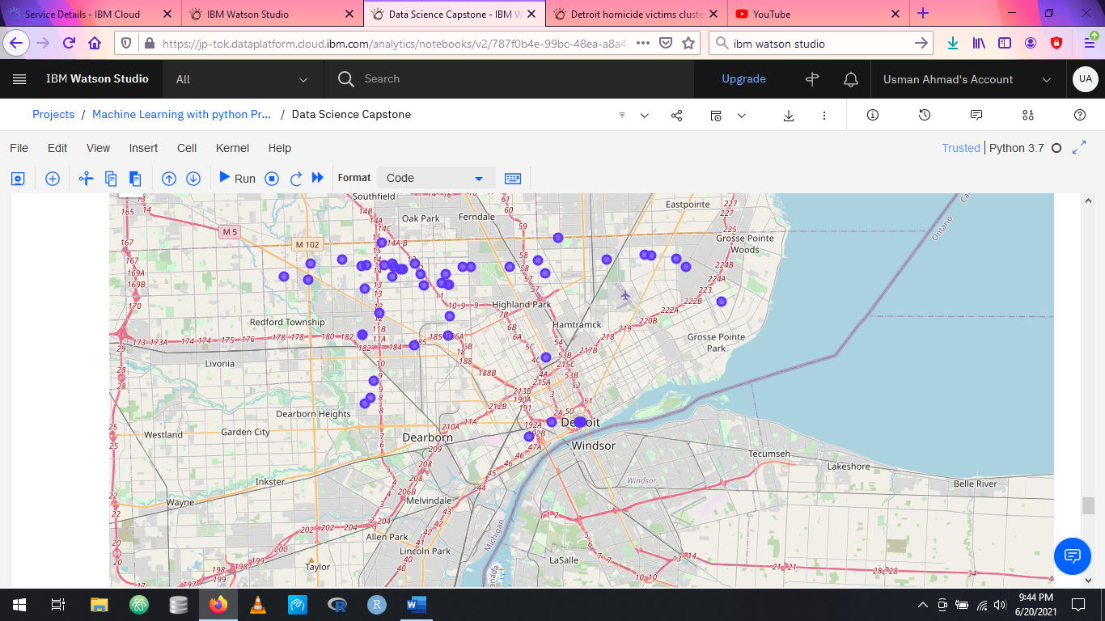
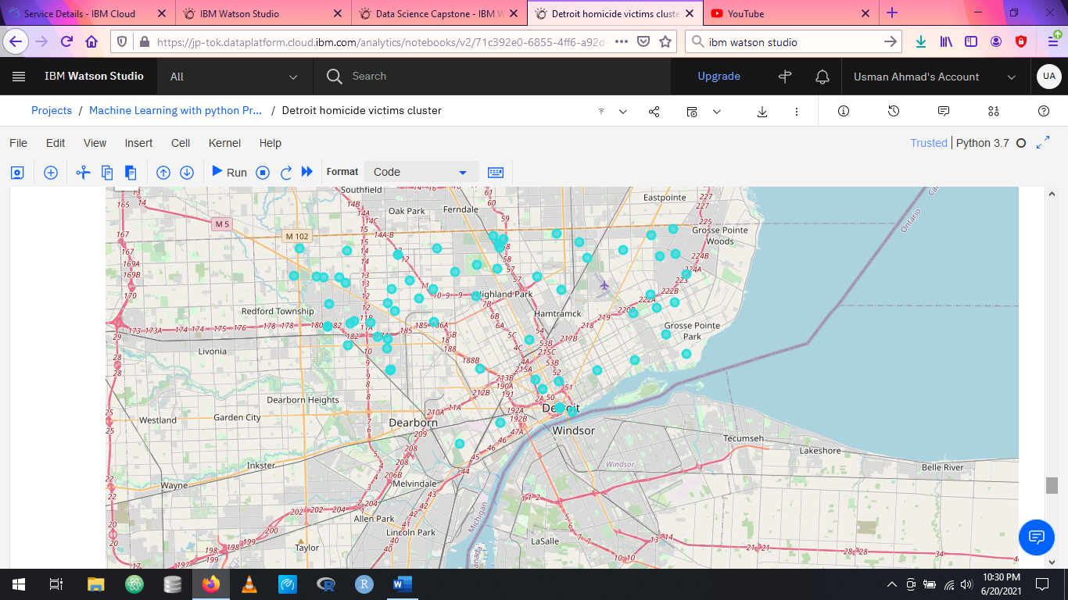
Liquor Store clusters
Homicides
Carjackings

Slide 11
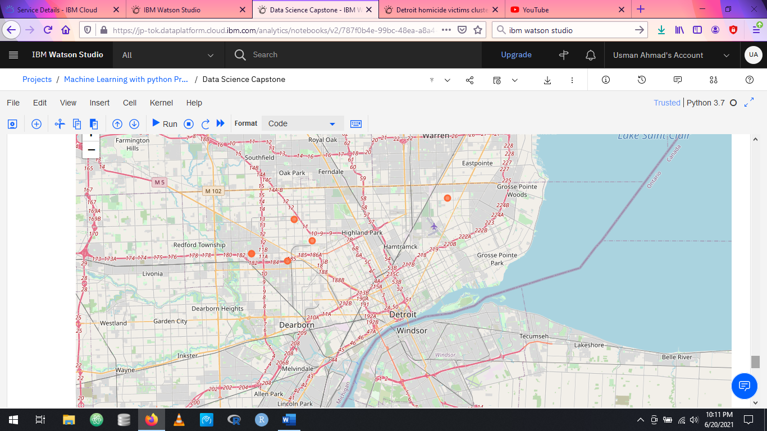
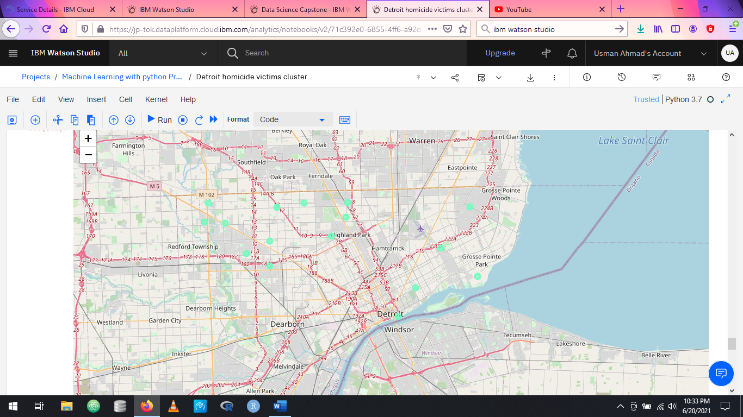
Construction site clusters
Homicides
Carjackings

Slide 12

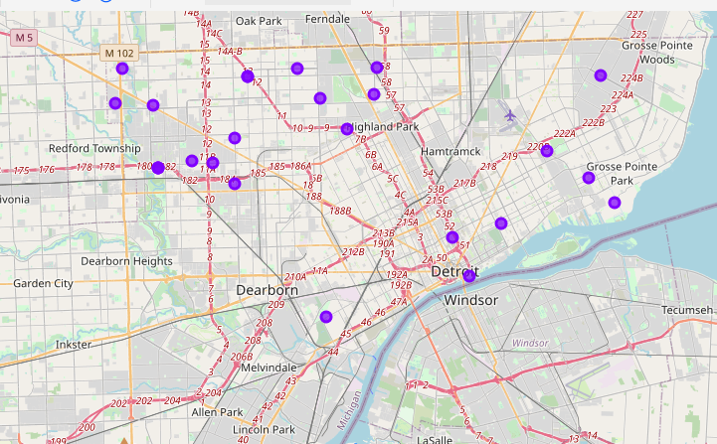
Convenience store clusters
Homicides
Carjackings

Slide 13
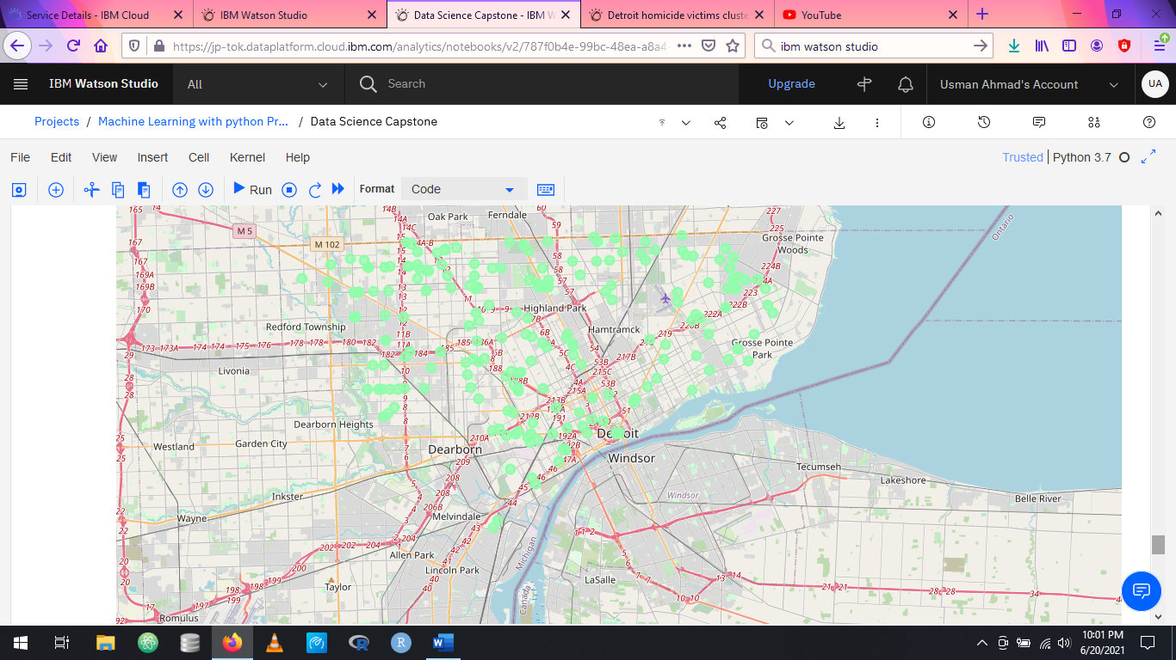
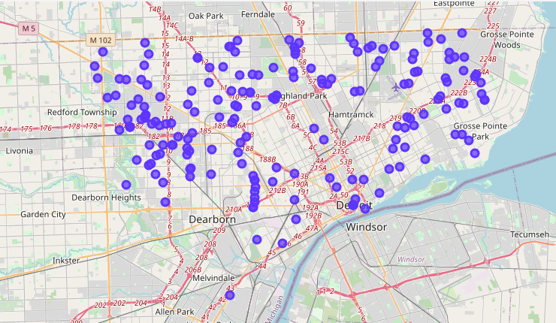
Coffee / sandwich / diner clusters
Homicides
Carjackings

Slide 14
Conclusion and future directions
Carjackings and Homicides do have some common / overlapping locations
More carjackings tend to happen around restaurants and fast-food places than homicides
More homicides were committed close to liquor stores, bars / wine bars
ATMs were more commonly found near homicide incidents
Additional data pertaining to following may be gathered for more deeper analysis
to sex of victims and offenders
venues economic
educational data
Volume of data may also be increased for more meaningful and correlated clusters

